Slide 1
Database Management: Pollution
Ruiyang Sun
Steven Yu

Slide 2
Tables
CO2 emission:(Country, Year, CO2_emission, Population, Area, % of World, Density)
World Population:(Country, Continent, 2015 Population, 2010Population, 2000Population, 1990Population, 1980Population, 1970Population, Area, Density, Growth, Percentage)
Temperature:(Country, dt, AverageTemperature, AverageTemperatureUncertainty)
GDP:(Country, 1960, 1961, 1962, …, 2021)
Energy consumption:(Entity, Year, Primary energy consumption)

Slide 3
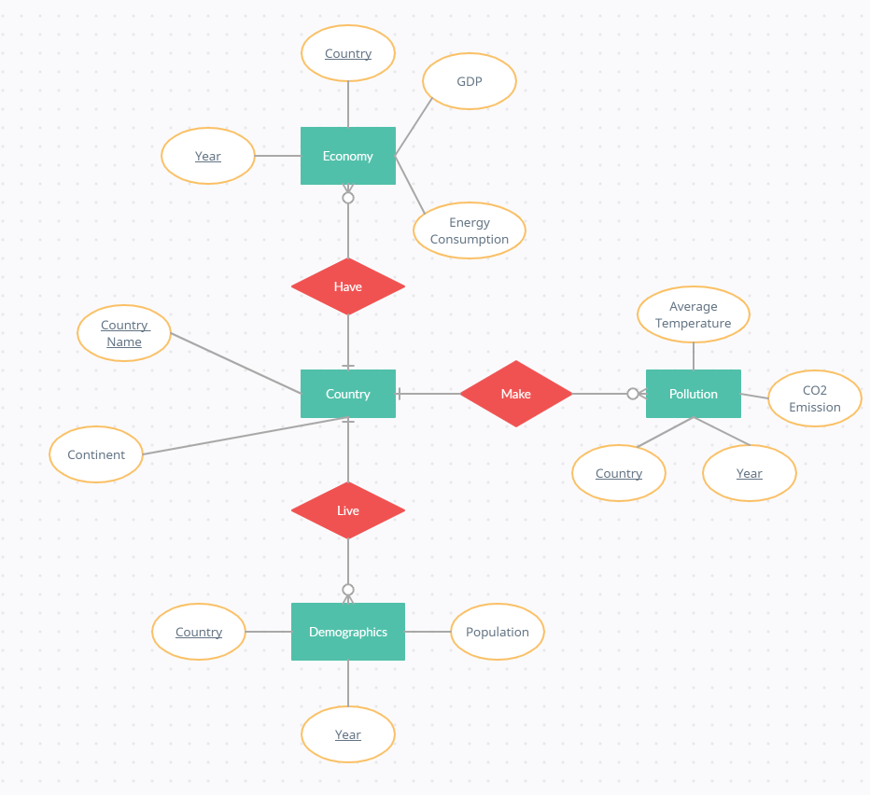
ER Diagram

Slide 4
Create DBMS: Preprocessing data
Only use data for year 1970, 1980, 1990, 2000, 2010, 2015 for our database
The Global Land Temperatures are recorded monthly, and have 574224 rows, which is unable to import into MySQL, so we calculated the average of each year in Excel and created a new table first
Change the Country Names to be consistent among these tables.

Slide 5
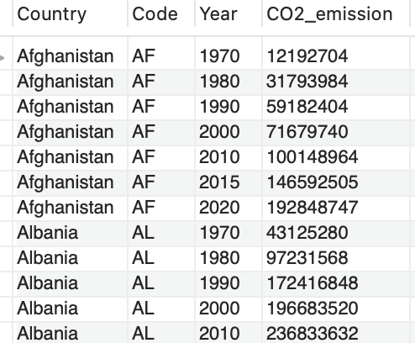
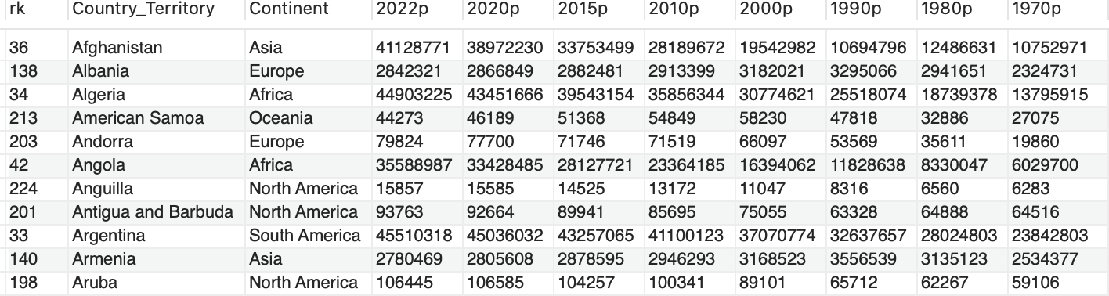
Create DBMS: Join the tables
Join the tables using Country and Year.
Tables have different structures: CO2, and Energy Consumption table have year as a key attribute, while GDP, Temperature and Population table have attributes dependent on years.
We cannot simply join tables with different structures.

Slide 6
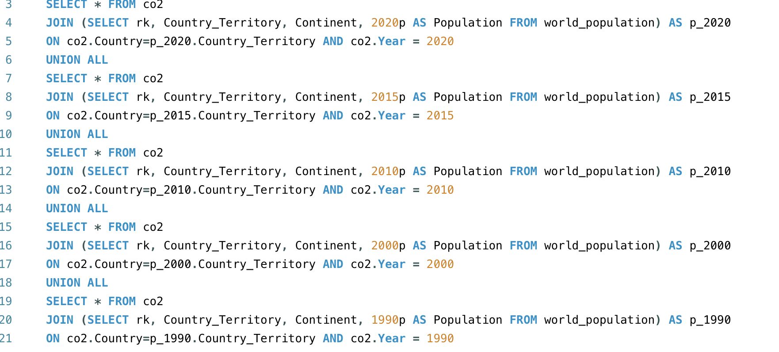
Create DBMS: Join the tables

Slide 7
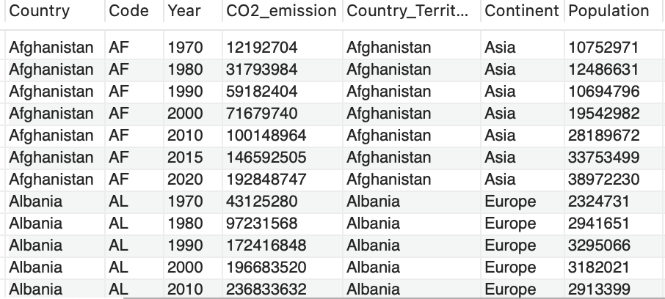
Create DBMS: Join the tables

Slide 8
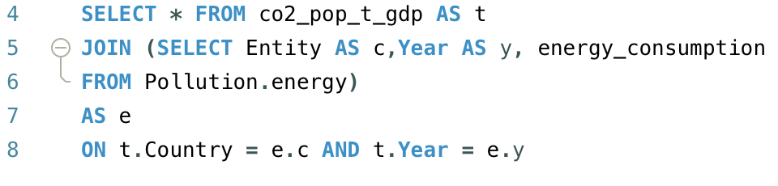
Create DBMS: Join the tables

Slide 9
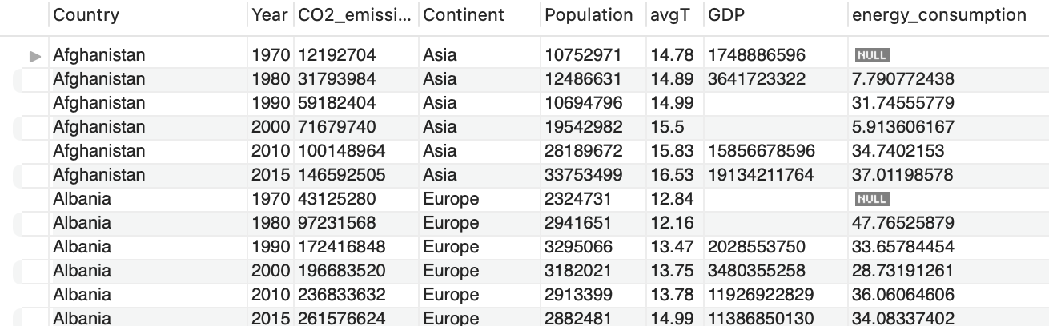
Create DBMS: 1NF
(Country, Year, CO2_emission, Continent, Population, avgT, GDP, energy_consumption)

Slide 10
Normalization: 1NF → 2NF
Primary Key: Country, Year
Partial dependency: Country → Continent
2NF:
(Country, Year, CO2_emission, Population, avgT, GDP, energy_consumption)
(Country, Continent)

Slide 11
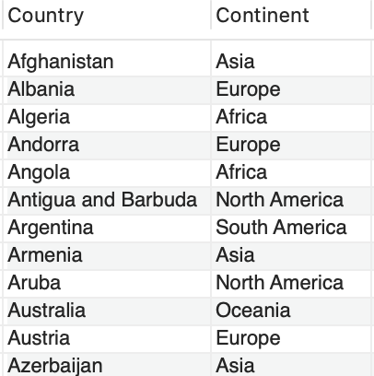
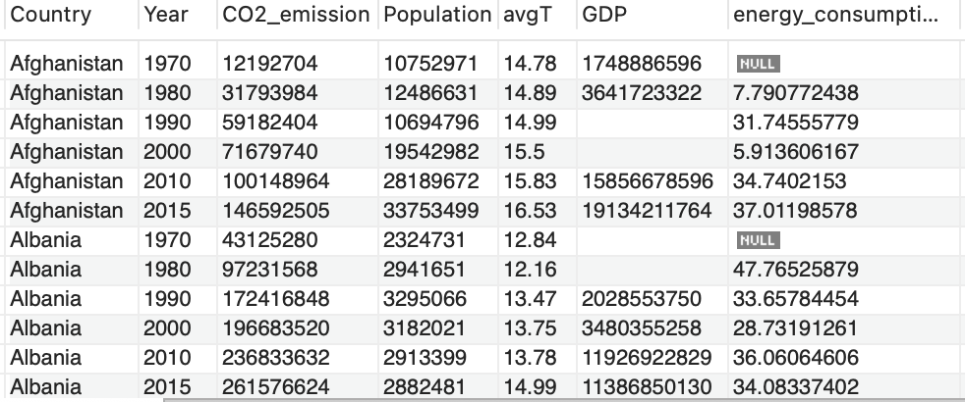
Normalization: 2NF (3NF)

Slide 12
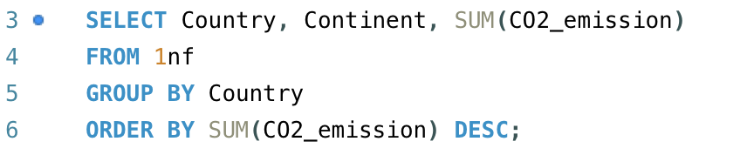
MySQL Queries 1
Countries emitting the most CO2 in total of the chosen years.

Slide 13
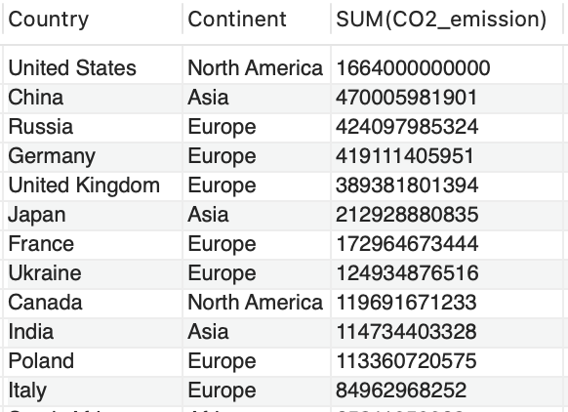

Slide 14
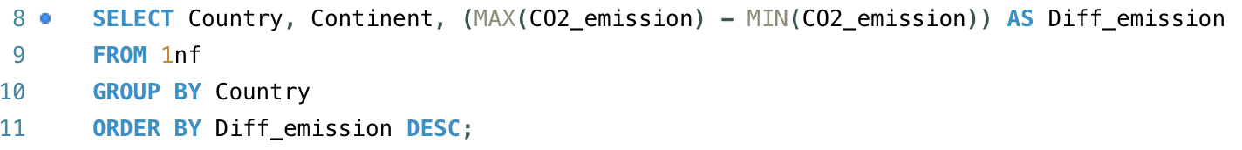
MySQL Queries 2
Countries with the biggest difference in CO2 emission from 1970 to 2015 (in most cases it means the increase of CO2 emission)

Slide 15
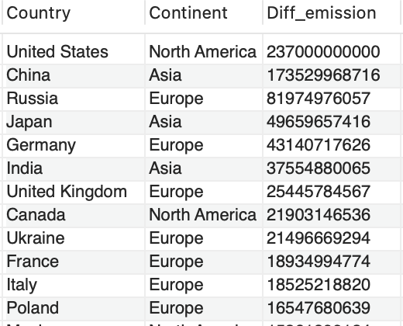

Slide 16
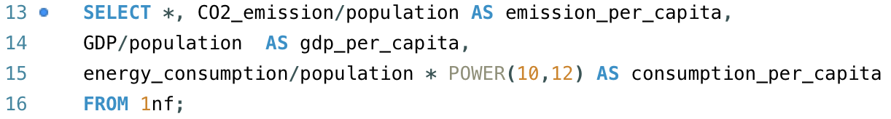
MySQL Queries 3
Shows the CO2 emission, GDP, and energy consumption per capita.

Slide 17
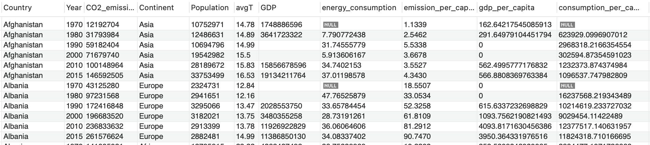

Slide 18
MySQL Queries 4
Compute the average population, average GDP, average energy consumption, and average CO2_emission of chosen years for each country.

Slide 19
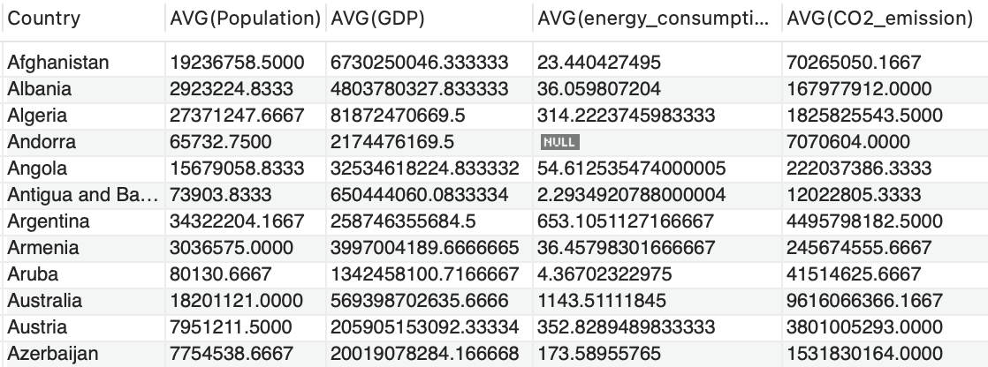

Slide 20
MySQL Queries 5
Compute the average population, average GDP, average energy consumption, and average CO2_emission of all countries in chosen years.

Slide 21
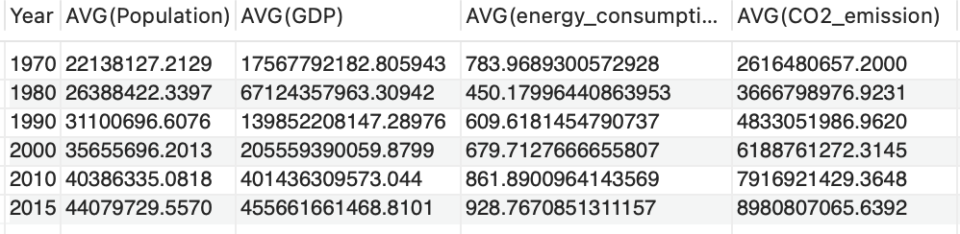

Slide 22
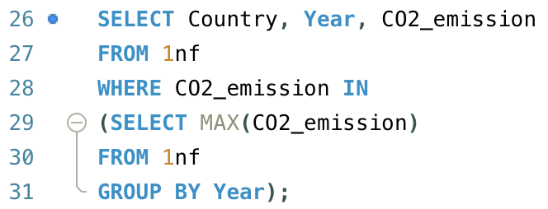
MySQL Queries 6
Countries emitting the most CO2 in chosen years.

Slide 23
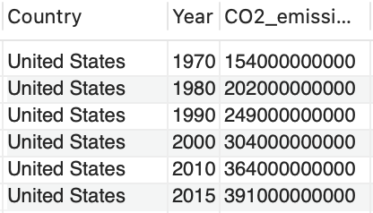

Slide 24
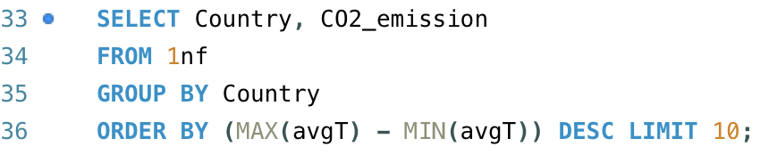
MySQL Queries 7
CO2 emission of countries with the biggest change in temperature

Slide 25
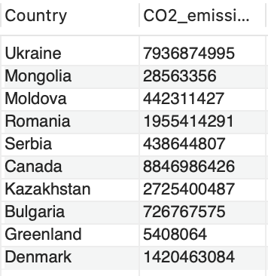

Slide 26
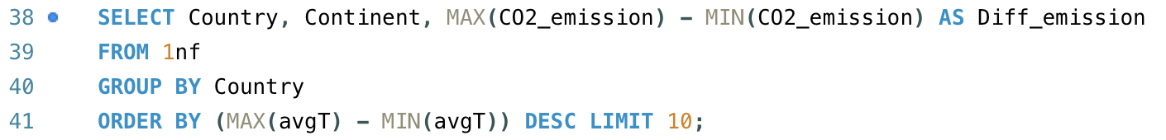
MySQL Queries 8
Change in CO2 emission of countries with the biggest change in temperature

Slide 27
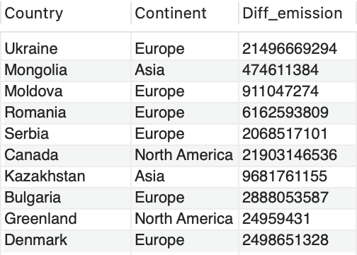

Slide 28
MySQL Queries 9
Change in CO2 emission per capita of countries with the biggest change in energy consumption per capita

Slide 29
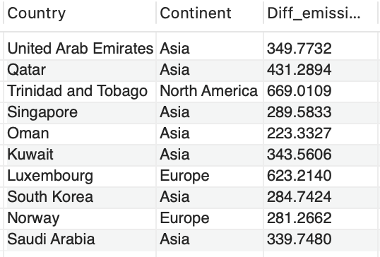

Slide 30
MySQL Queries 10
Countries with the biggest difference in CO2 emission per capita from 1970 to 2015

Slide 31
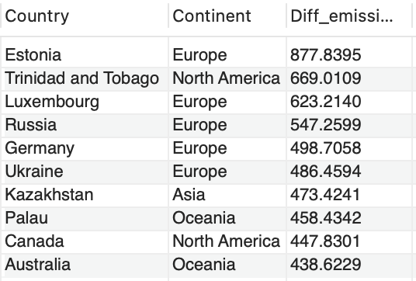

Slide 32
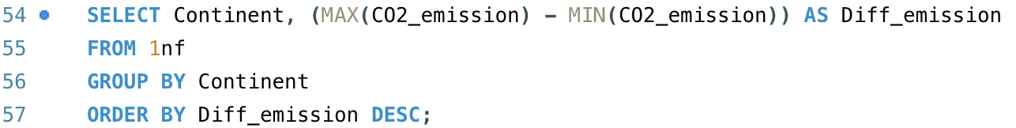
MySQL Queries 11
Continents with the biggest difference in CO2 emission from 1970 to 2015

Slide 33
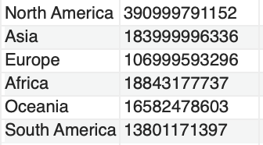

Slide 34
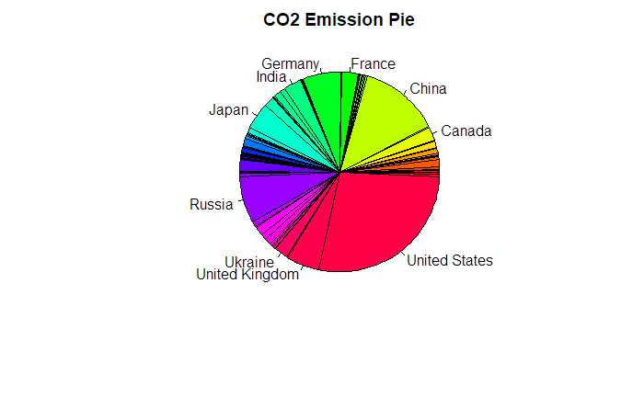
CO2 Emission in 2015

Slide 35
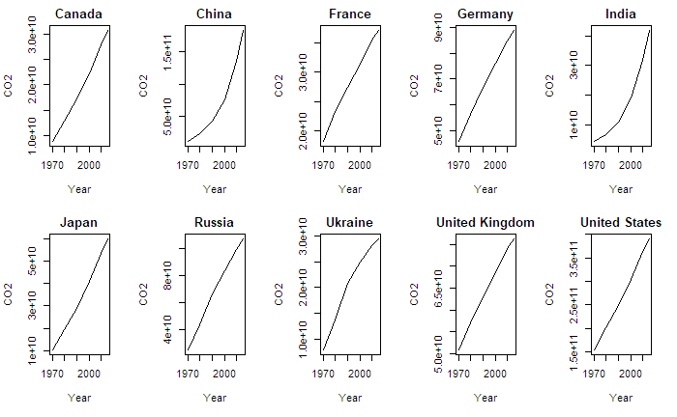

Slide 36
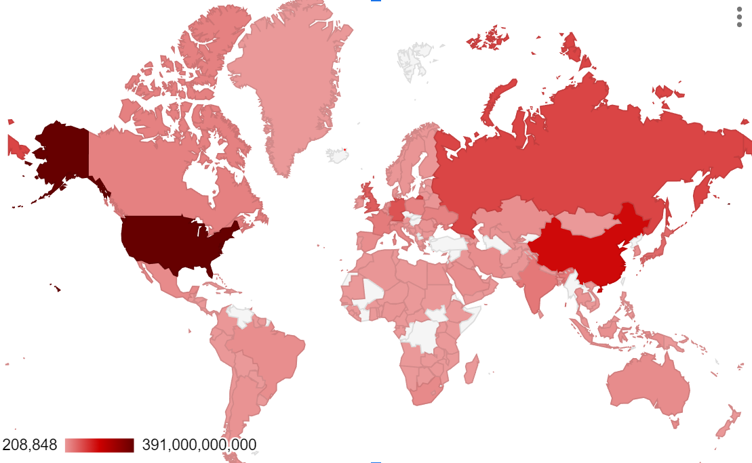
Geo chart of CO2 emission in 2015

